Slide 1
CSYE_7220
Mid TERM assignment
Created by Junma & Shams Naimi

Slide 2

OUR PROJECT
We have developed a bus booking app allowing user to book ticket from one destination to another on different route and on various dates
YOUR LOGO

Slide 3



CREATION
Front end
Back end
Deployment
We are using a react app with material UI, the app is deployed on Nginx
We have created a python flask app running on gunicorn
We deployed our app on a linus based aws server which had an ubunto OS

Slide 4
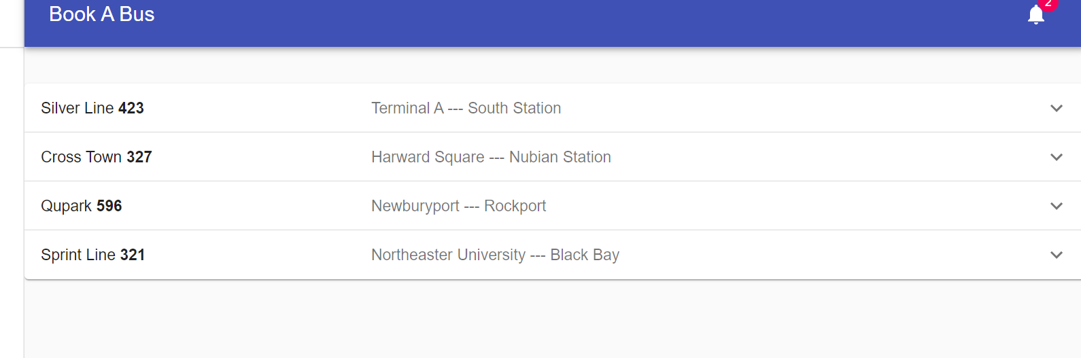
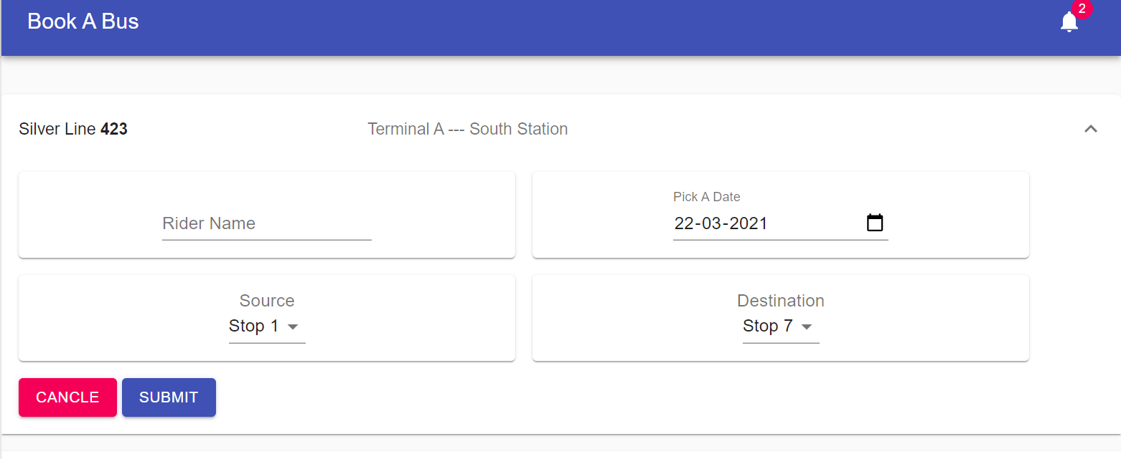
Booking pages
This page allows to create a booking on multiple lanes

Slide 5
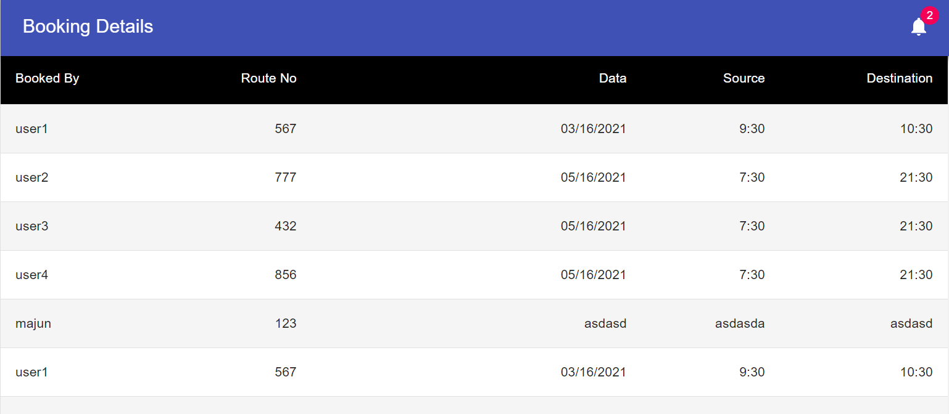
DETAIL PAGE

Slide 6
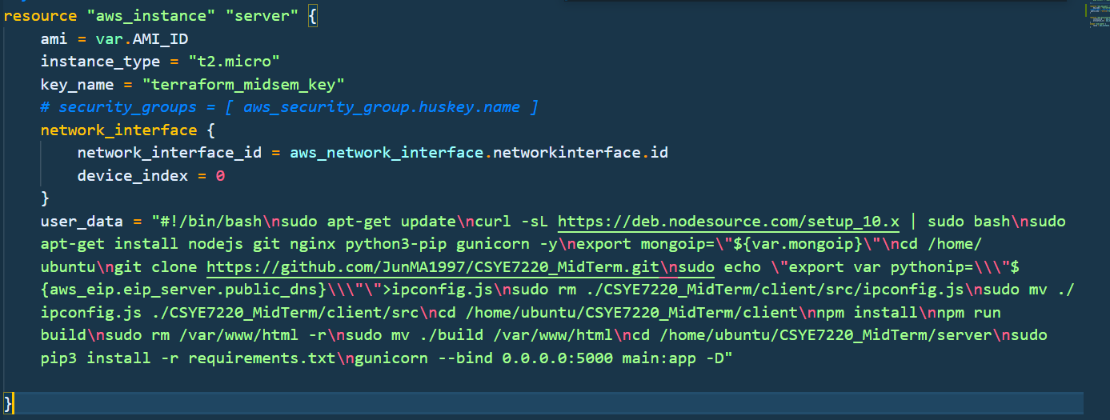
Deployment
We have used Terraform to deploy our app and have used user data to automate our deployment

Slide 7
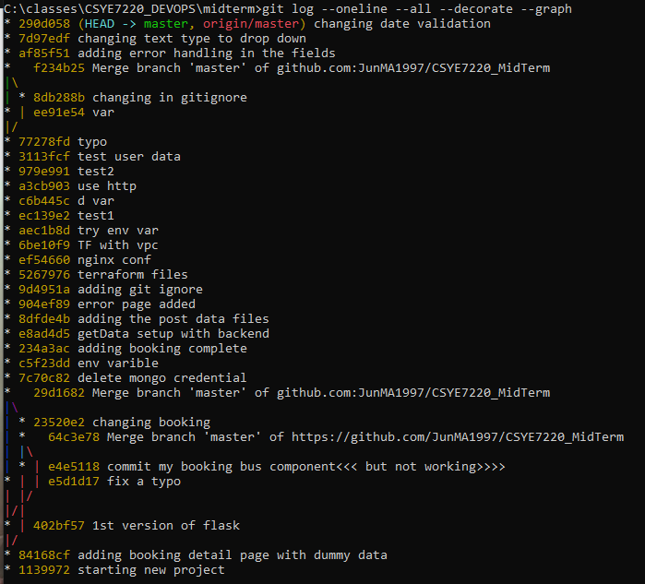
OUR GIT REPO

Slide 8
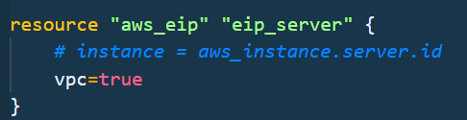
Elatic IP
for the Elastic Ip we have used Terrafrorm aws_eip to create and assign an elastic ip to our app

